Slide 1

Motilal Nehru National Institute of Technology, Allahabad Project on FRACTALS Course: MCA I Semester – Programming and Problem Solving
Submitted To: Prof. M.M. Gore Course: MCA I Semester
Subject: Programming and Problem Solving

Slide 2
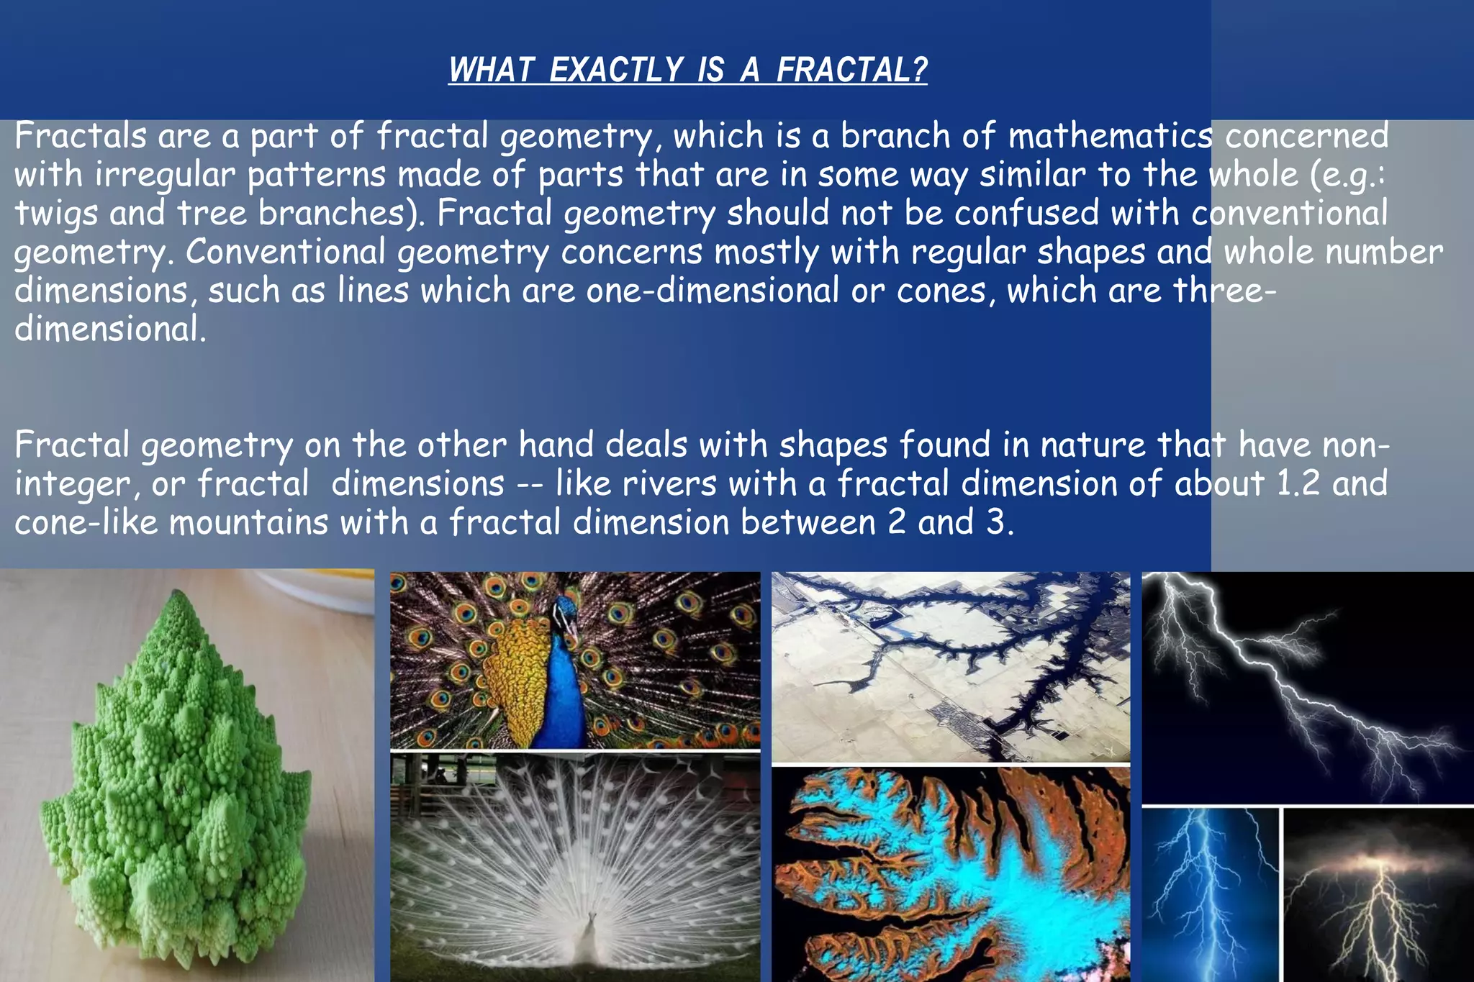
WHAT EXACTLY IS A FRACTALS ?
Fractals are infinite, self-similar patterns generated using iterative equations.
Widely visible in nature: trees, clouds, lightning, galaxy patterns.
Computer-generated fractals rely on complex numbers and recursion.
In this project, we implemented Mandelbrot, BurningShip, and Tricorn fractals using C programming.

Slide 3
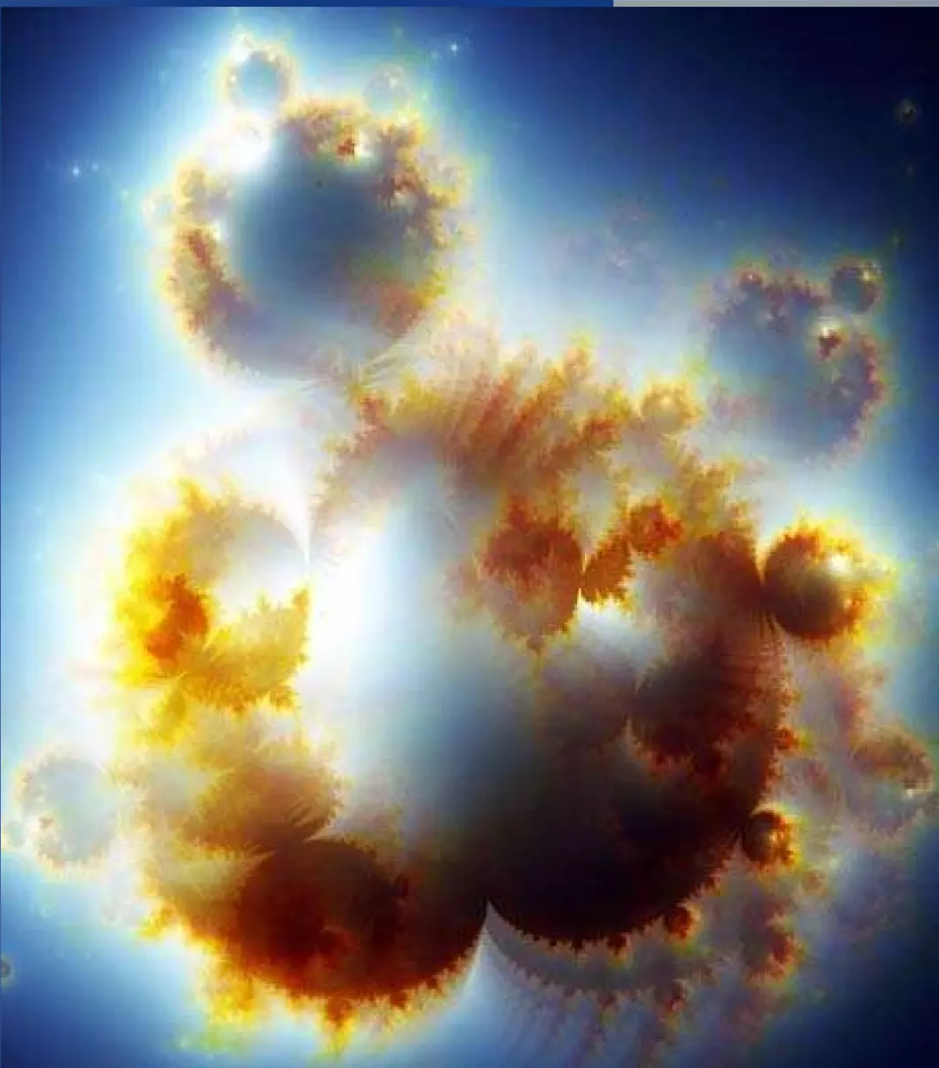
HISTORY OF FRACTALS

Slide 4
Project Objectives
Implement Mandelbrot, Burningship, and Tricorn fractal algorithms in C.
Use PBM (Portable Bitmap) format for simple binary (0/1) image output.
Map each pixel to complex plane coordinates.
Apply escape-time algorithm to generate fractal boundaries.
Automate compilation using Makefile.
Generate black & white fractal images without external graphics libraries.
Prepare comprehensive project report, output files, and presentation slides.

Slide 5
Contributions (Members 1 & 2)
Member 1: Dibyendu Das
Introduced the project and assigned responsibilities.
Ensured smooth coordination among teammates.
Helped derive iterative equations.
Worked on project introduction and theory.
Member 2: Piyush Gautam
Assisted in setting up C environment.
Researched fractals and mathematical background.
Created initial complex plane mapping logic.
Helped debug Mandelbrot implementation.

Slide 6
Contributions (Members 3 & 4)
Member 3: Divyajeet
Implemented mandelbrot.c core algorithm.
Coded escape-time function using
z = z*z + c.
Set iteration limits and bounding values.
Member 4: Rajeev Tirkey
Validated output at different coordinate ranges.
Centered the fractal for better symmetry.
Generated sample mandelbrot.pbm outputs.

Slide 7
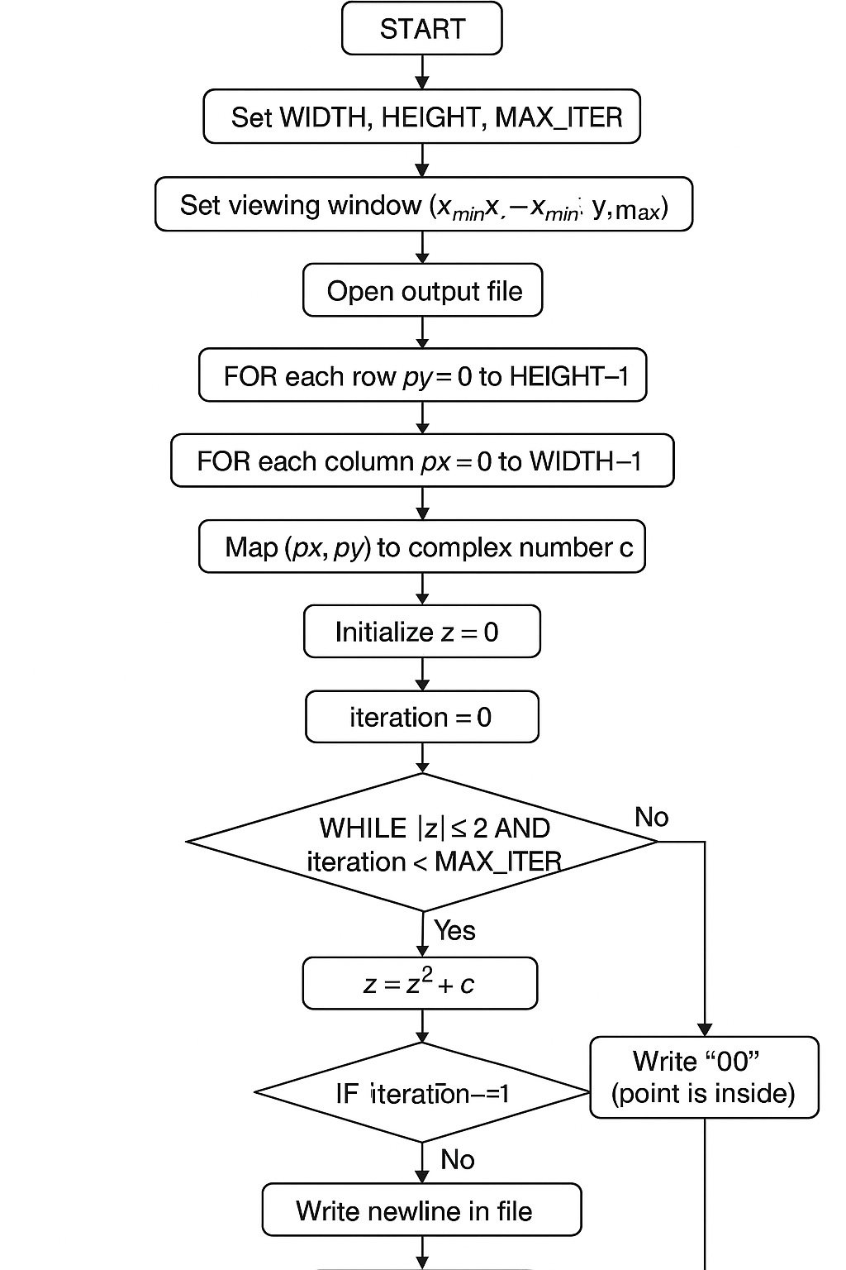
Mandelbrot Set (Algorithm)
Steps:
Initialize parameters — width, height, max iterations.
Loop over each pixel on the screen.
Map pixel to complex coordinate (x + yi).
Apply iteration:
z = z² + c
Assign output 0 or 1 depending on escape status..
Save pixel data to file.

Slide 8
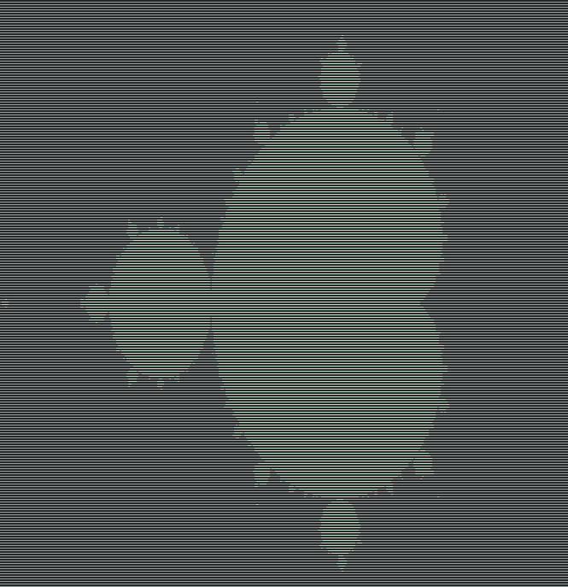
Code Snippet
Code Output
// Escape-time function
int mandelbrot(double complex c) {
double complex z = 0;
int n = 0;
while (cabs(z) <= 2.0 && n < MAX_ITER) {
z = z*z + c; // z = f(z,c)
n++;
}
return (n == MAX_ITER); // 1 = inside, 0 = outside
}
for (int py = 0; py < HEIGHT; py++) {
for (int px = 0; px < WIDTH; px++) {
double x = x_min + (x_max - x_min) * px / (WIDTH - 1);
double y = y_min + (y_max - y_min) * py / (HEIGHT - 1);
double complex c = x + y * I;
int inside = mandelbrot(c);
fprintf(fp, inside ? "0" : "1");
}
fprintf(fp, "\n");
}

Slide 9
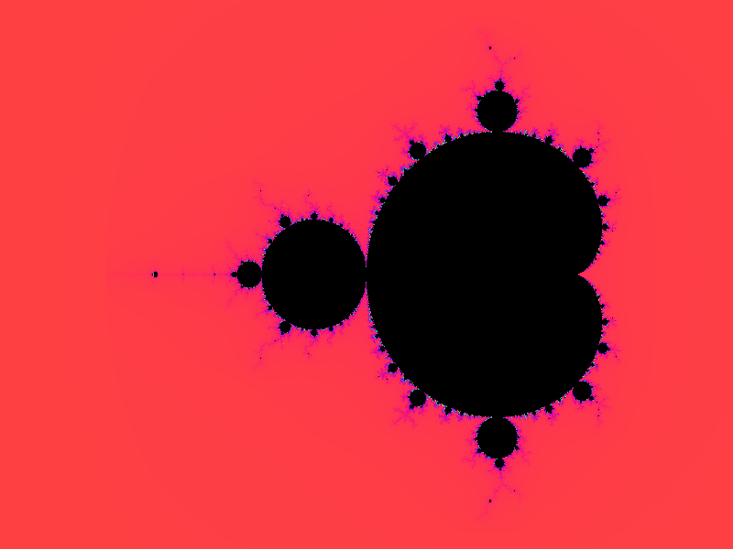
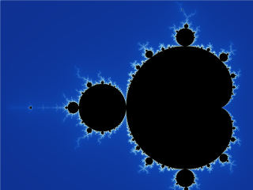

Slide 10
Contributions (Members 5 & 6)
Member 5: Smruti Ranjan
Implemented Burning Ship Set algorithm in C.
Worked on applying absolute values fabs(a) and fabs(b) before squaring.
Selected correct coordinate ranges (x_min, x_max, y_min, y_max).
Ensured MAX_ITER = 5000 for detailed spike-like structure.
Member 6: Mohd Sufiyan
Handled output formatting (text-based output using “00” and “11”).
Helped debug pixel mapping and escape condition logic.
Tested and validated the Burning Ship output pattern.
Ensured the fractal displays the characteristic “flame-like” pattern.

Slide 11
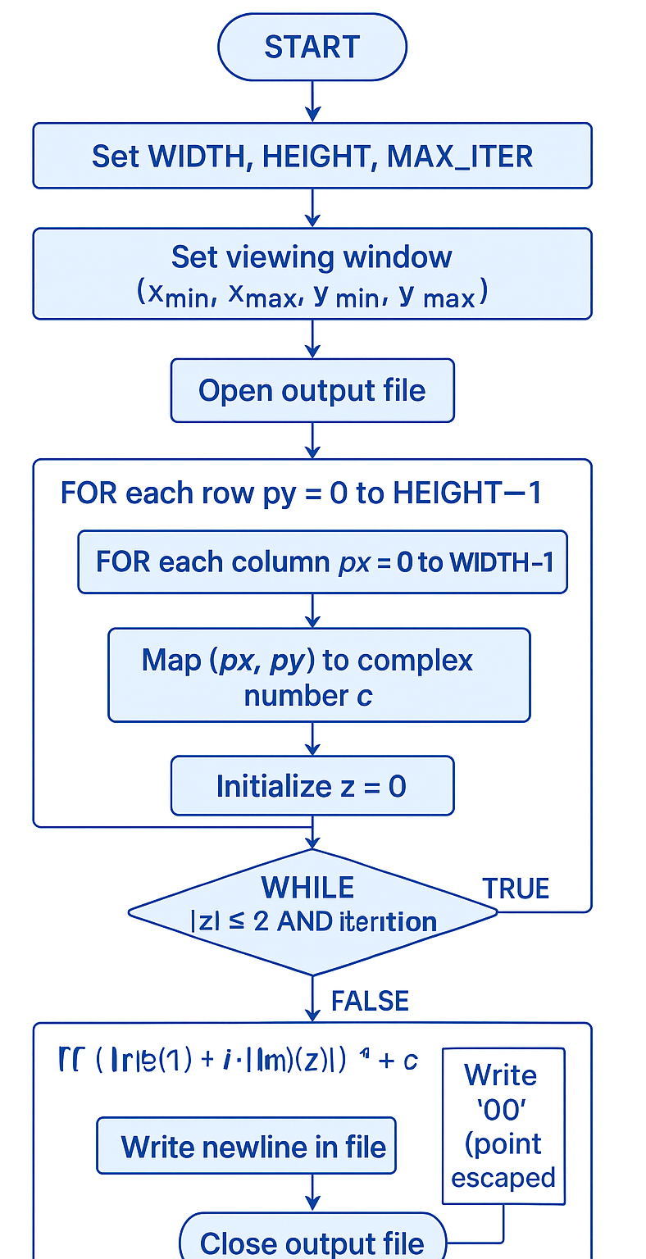
Burningship Set (Algorithm)
Steps:
Initialize parameters — width, height, max iterations.
Loop over each pixel on the screen.
Map pixel to complex coordinate (x + yi).
Apply iteration:
z = (|Re(z)| + i·|Im(z)|)² + c.
Assign output 0 or 1 depending on escape status..
Save pixel data to file.

Slide 12
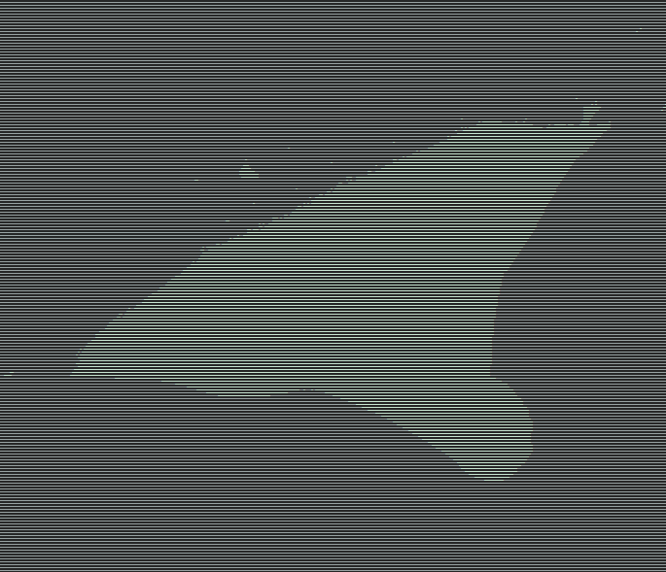
Code Snippet
Code Output
// Escape-time function
int burningship(double complex c) {
double complex z = 0;
int n = 0;
while (cabs(z) <= 2.0 && n < MAX_ITER) {
double a = fabs(creal(z)); // |Re(z)|
double b = fabs(cimag(z)); // |Im(z)|
z = (a + b * I) * (a + b * I) + c; // z = (|a| + i|b|)^2 + c
n++;
}
return (n == MAX_ITER); // 1 = inside, 0 = outside
}
for (int py = 0; py < HEIGHT; py++) {
for (int px = 0; px < WIDTH; px++){
double x = x_min + (x_max - x_min) * px / (WIDTH - 1);
double y = y_min + (y_max - y_min) * py / (HEIGHT - 1);
double complex c = x + y * I;
int inside = burningship(c);
fprintf(fp, inside ? "0" : "1");
}
fprintf(fp, "\n");
}

Slide 13
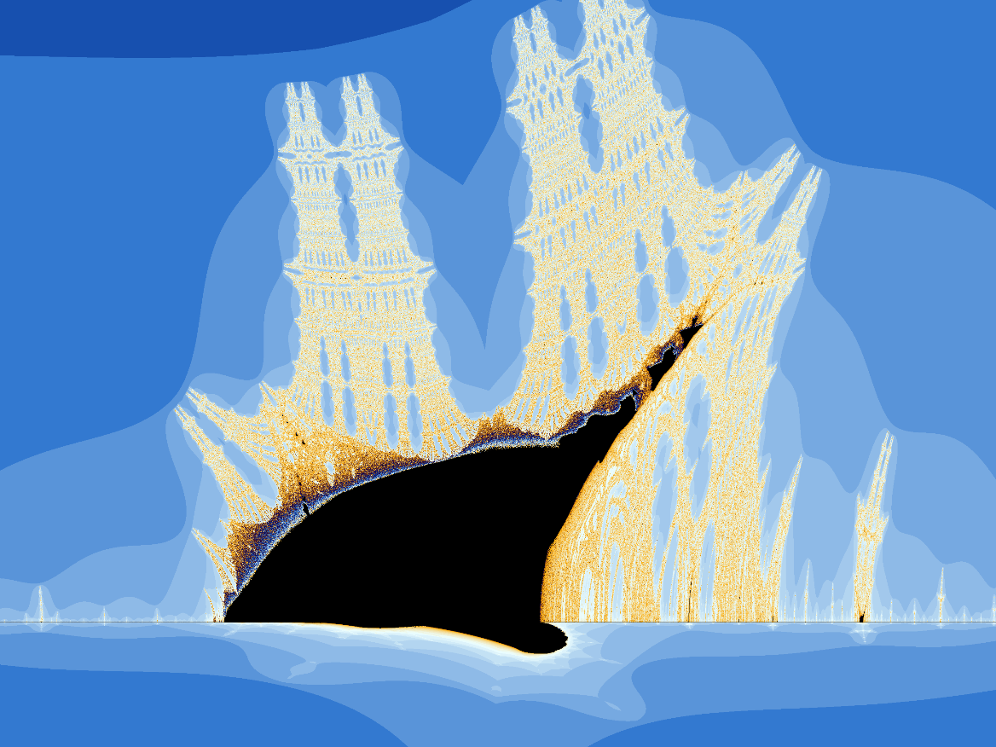
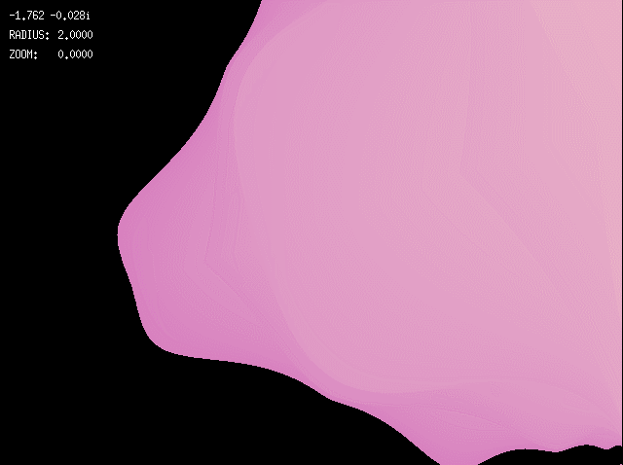

Slide 14
Contributions (Members 7 & 8)
Member 7: Manish Kumar
Implemented tricorn_set.c.
Used anti-holomorphic iteration:
z = conj(z)^2 + c.
Researched Tricorn’s three-fold symmetry.
Member 8: Sumit Raj Chaudhary
Compared visual differences between fractal types.
Generated PBM images for testing and documentation.
Integrated files into final output folder.

Slide 15
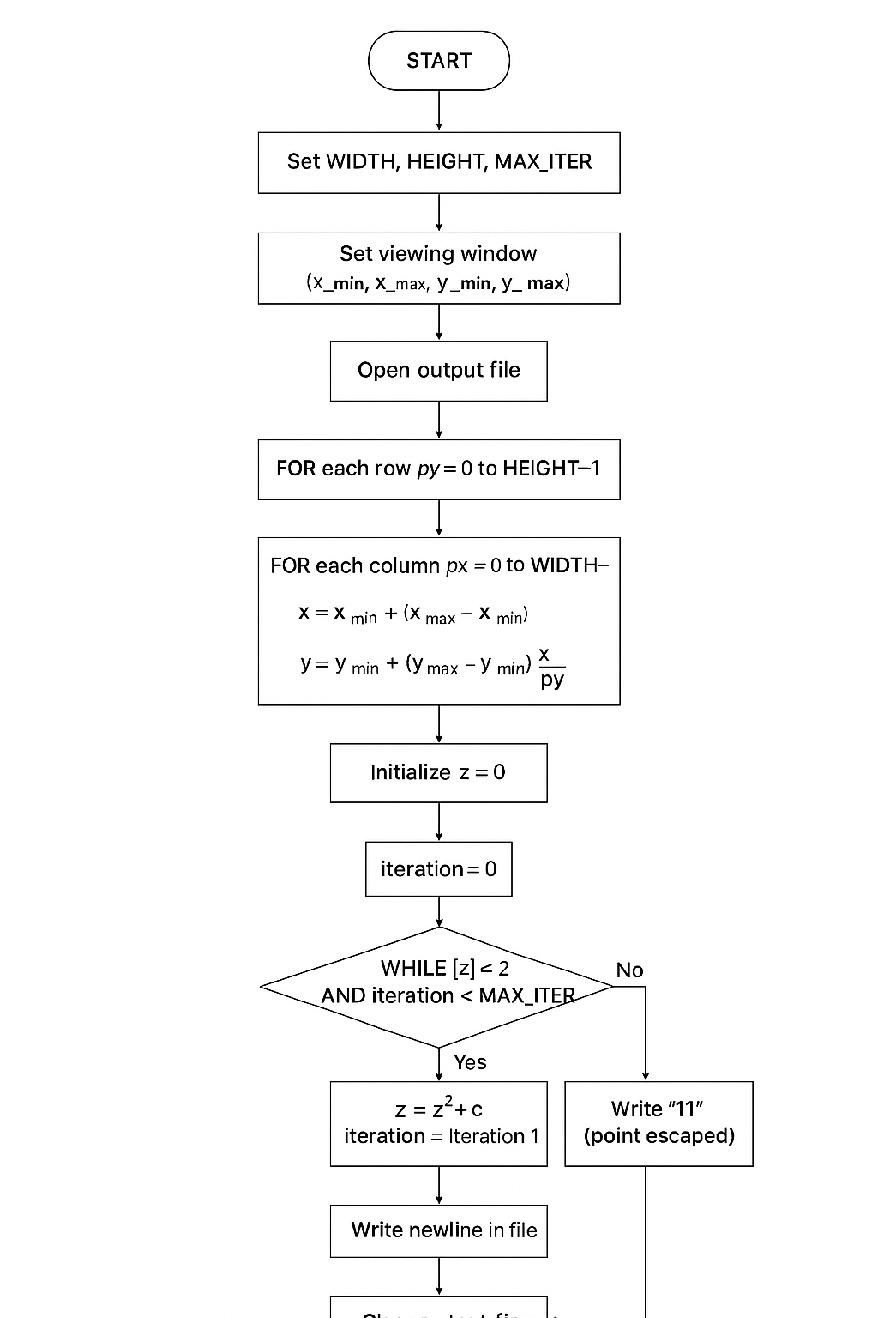
Tricorn Set (Algorithm)
Steps:
Initialize parameters — width, height, max iterations.
Loop over each pixel on the screen.
Map pixel to complex coordinate (x + yi).
Apply iteration:
z = conj(z²) + c
Assign output 0 or 1 depending on escape status..
Save pixel data to file.

Slide 16
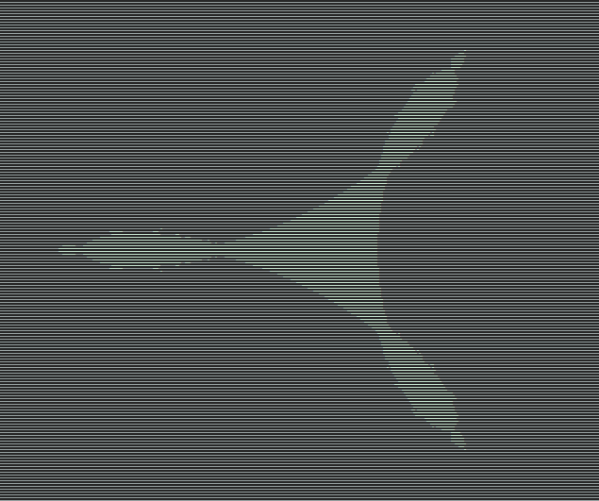
Code Snippet
Code Output
// Escape-time function
int tricorn(double complex c) {
double complex z = 0;
int n = 0;
while (cabs(z) <= 2.0 && n < MAX_ITER) {
z = conj(z*z) + c; // z = conjugate(z²) + c
n++;
}
return (n == MAX_ITER); // 1 = inside, 0 = outside
}
for (int py = 0; py < HEIGHT; py++) {
for (int px = 0; px < WIDTH; px++) {
double x = x_min + (x_max - x_min) * px / (WIDTH - 1);
double y = y_min + (y_max - y_min) * py / (HEIGHT - 1);
double complex c = x + y * I;
int inside = tricorn(c);
fprintf(fp, inside ? "0" : "1");
}
fprintf(fp, "\n");
}

Slide 17
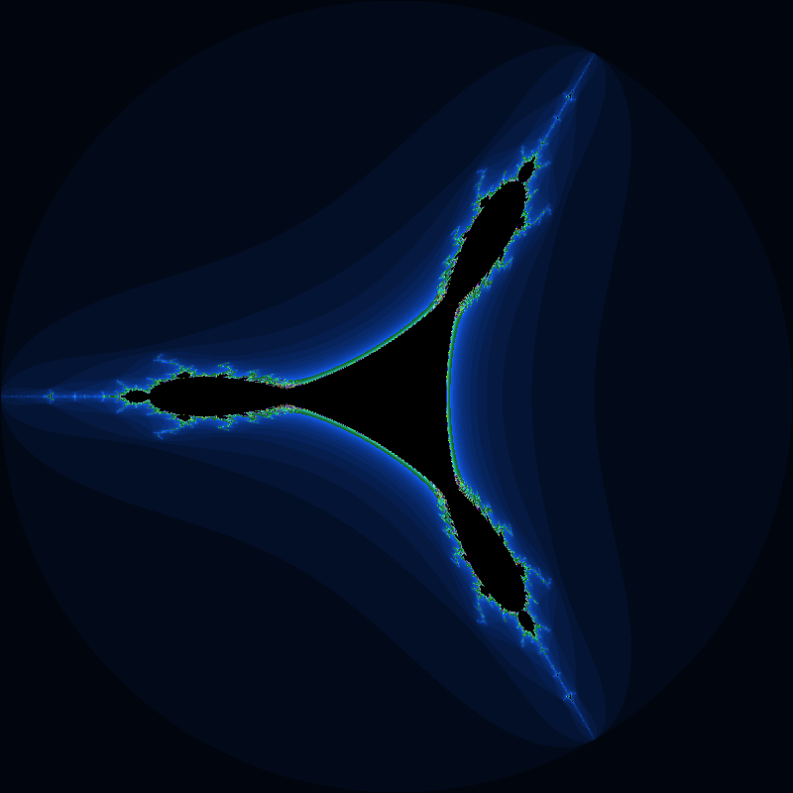
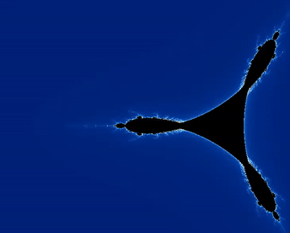

Slide 18
Contributions (Members 9 & 10)
Member 9: Shri Krishan
Created Makefile for automating compilation.
Organized object file rules & clean targets.
Ensured smooth compilation of all three fractals.
Member 10: Rajdeep Gupta
Worked on optimization and code cleanup.
Performed debugging for segmentation faults & slow runs.
Prepared sample images for PPT/report.

Slide 19
Contributions (Members 11 & 12)
Member 11: Jitendra Singh
Wrote major sections of project report (methodology, results).
Collected screenshots and outputs.
Helped in final formatting.
Member 12: Amit Singhad
Designed the PPT.
Manages all the output.
Handled final submission and documentation.

Slide 20
Makefile & Build Automation
Compiles all three .c files automatically.
Supports commands:
make → builds executables
make clean → removes binary & PBM outputs.
Simplifies multi-file compilation.
Ensures consistent build process for demonstration.
Reduces manual compilation errors.

Slide 21
Results & Observations
Successfully generated PBM images for all fractals.
Mandelbrot: recognizable cardioid & bulb structure.
Julia: shape varies dramatically with constant c.
Tricorn: characteristic three-wing symmetric fractal.
PBM’s 0/1 format provides:
high contrast
small file size
easy debugging
Escape-time algorithm produced clear boundaries.

Slide 22
Conclusion & Future Work
Conclusion:
Implemented fractal generation using C and PBM format.
Understood complex numbers, iteration, and escape-time logic.
Automated workflows using Makefile.
Achieved clean black & white fractal outputs.
Future Scope:
Add grayscale (PGM) and color (PPM) visualization.
Implement zooming and panning.
Convert PBM into video animations.
GPU-based fractal rendering for real-time performance.

Slide 23
THANK YOU

